Slide 1


Slide 2
A Programmatic Introduction to Neo4j
Ian Robinson
http://ianSrobinson.com
@ianSrobinson
Jim Webber
http://jimwebber.org
@jimwebber

Slide 3
Logistics
XX:YY Coffee break
XX:YY Coffee lunch
XX:YY Coffee break
Remember to complete the evaluation forms

Slide 4
Roadmap
Hello, Timelords!
NOSQL overview
Neo4j fundamentals and tools
Neoclipse, Neo4j shell
Core API
Indexing
Traverser APIs
Graph algorithms
REST API
Solutions architecture and big data

Slide 5
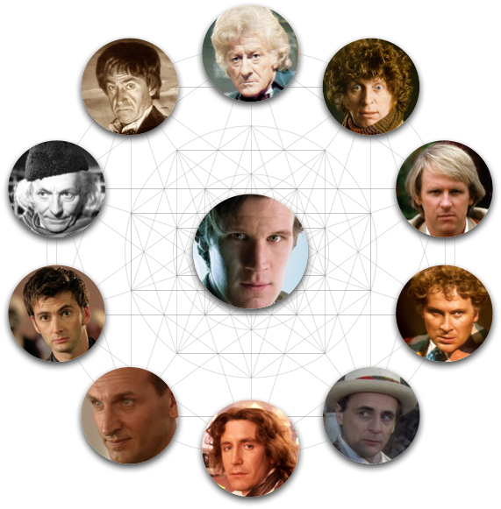
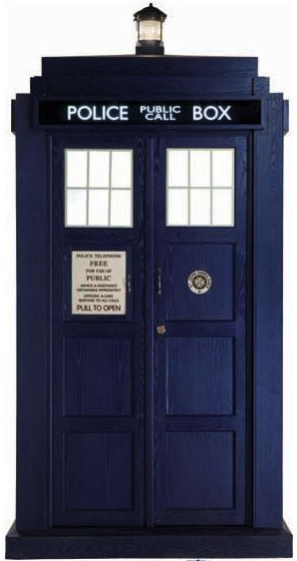
The Doctor

Slide 6
Not Only SQL
NOSQL is simply…
Notes:
Future stores will be mixed – right shape for the right job
Polyglot persistence
Frameworks (e.g. spring data) embracing this already

Slide 7
Why NOSQL now?
Driving trends

Slide 8
Trend 1: Data Size

Slide 9
Trend 2: Connectedness
GGG
Onotologies
RDFa
Folksonomies
Tagging
Wikis
Information connectivity
UGC
Blogs
Feeds
Hypertext
Text Documents
Notes:
UGC = User Generated Content
GGG = Giant Global Graph (what the web will become)

Slide 10
Trend 3: Semi-structured information
Individualisation of content
1970’s salary lists, all elements exactly one job
2000’s salary lists, we need many job columns!
All encompassing “entire world views”
Store more data about each entity
Trend accelerated by the decentralization of content generation
Age of participation (“web 2.0”)

Slide 11
Side note: RDBMS performance
Notes:
This is strictly about connected data – joins kill performance there.
No bashing of RDBMS performance for tabular transaction processing

Slide 12
Trend 4: Architecture
1980’s: Single Application
Application
DB

Slide 13
Trend 4: Architecture
1990’s: Integration
Database Antipattern
Application
Application
Application
DB

Slide 14
Trend 4: Architecture
2000’s: SOA
RESTful, hypermedia, composite apps
Application
Application
Application
DB
DB
DB

Slide 15
Four NOSQL Categories

Slide 16
Key-Value Stores
“Dynamo: Amazon’s Highly Available Key-Value Store” (2007)
Data model:
Global key-value mapping
Big scalable HashMap
Highly fault tolerant (typically)
Examples:
Riak, Redis, Voldemort
Notes:
History – Amazon decide that they always wanted the shopping basket to be available, but couldn’t take a chance on RDBMS
So they built their own
Big risk, but simple data model and well-known computing science underpinning it (e.g. consistent hashing, Bloom filters for sensible replication)
+ Massive read/write scale
- Simplistic data model moves heavy lifting into the app tier (e.g. map reduce)

Slide 17
Pros and Cons
Strengths
Simple data model
Great at scaling out horizontally
Weaknesses:
Simplistic data model
Poor for complex data

Slide 18
Column Family (BigTable)
Google’s Bigtable: A Distributed Storage System for Structured Data” (2006)
Data model:
A big table, with column families
Map-reduce for querying/processing
Examples:
Hbase, HyperTable, Cassandra

Slide 19
Pros and Cons
Strengths
Data model supports semi-structured data
Good at scaling out horizontally
Weaknesses:
Unsuited for interconnected data

Slide 20
Document Databases
Derived from Lotus Notes(!)
Data model
Collections of documents
A document is a key-value collection
Index-y, lots of map-reduce
Examples
CouchDB, MongoDB

Slide 21
Pros and Cons
Strengths
Simple, powerful data model (just like SVN!)
Can be reasonable at scaling
Weaknesses:
Unsuited for interconnected data
Query model limited to keys
Map reduce for larger queries
Notes:
Mongo DB has a reputation for taking liberties with durability to get speed
Couch DB has good multimaster replication from Lotus Notes

Slide 22
Graph Databases
Data model:
Nodes with properties
Typed relationships with properties
Examples:
Sones GraphDB, OrientDB, InfiniteGraph
Notes:
People talk about Codd’s relational model being mature because it was proposed in 1969 – 42 years old.
Euler’s graph theory was proposed in 1736 – 275 years old.

Slide 23
Pros and Cons
Strengths
Powerful data model
Fast
For connected data, can be many orders of magnitude faster than RDBMS
Weaknesses:
Sharding
Though they can scale reasonably well
Notes:
Can’t easily shard graphs like documents or KV stores.
This means that high performance graph databases are limited in terms of data set size that can be handled by a single machine.
Can use replicas to speed things up (and improve availability) but limits data set size limited to a single machine’s disk/memory.
Some domains can shard easily (.e.g geo, most web apps) using consistent routing approach and cache sharding – we’ll cover that later.

Slide 24
What are graphs good for?
Recommendations
Business intelligence
Social computing
Geospatial
MDM
Systems management
Web of things
Genealogy
Time series data
Product catalogue
Web analytics
Scientific computing (especially bioinformatics)
Indexing your slow RDBMS
And much more!

Slide 25
Neo4j is a Graph Database
So we need to detour through a little graph theory

Slide 26

Meet Leonhard Euler
Swiss mathematician
Inventor of Graph Theory (1736)
http://en.wikipedia.org/wiki/File:Leonhard_Euler_2.jpg

Slide 27



http://en.wikipedia.org/wiki/Seven_Bridges_of_Königsberg
Notes:
Euler reduced the problem into an abstract form
From geography to diagrammatic through to a graph.
It’s the first documented case of representing the real world as a graph.

Slide 28
On maturity of data models
Notes:
Codd’s RDBMS is heralded as the gold standard for enterprise data because of its maturity, yet Codd’s model is only 42 years old in 2011
Euler’s graph model is 275 years old!

Slide 29
Property Graph Model

Slide 30
Property Graph Model
TRAVELS_WITH
LOVES
TRAVELS_WITH
OWNS
TRAVELS_IN

Slide 31
Property Graph Model
name: the Doctor
age: 907
species: Time Lord
TRAVELS_WITH
LOVES
TRAVELS_WITH
first name: Rose
late name: Tyler
BORROWED
TRAVELS_IN
vehicle: tardis
model: Type 40

Slide 32

Graphs are very whiteboard-friendly
Notes:
Start off sketching the domain. That’s your model done – we see this when we revisit databases months after they’re been designed and put into production
No decomposition, ER design, normalisation/denormalisation as you need with RDBMS.

Slide 33
This has huge design implications

Slide 34

What you end up with
What you know
Your awesome new graph database
http://talent-dynamics.com/tag/sqaure-peg-round-hole/
Notes:
Common design misunderstanding is to impose a relational model onto the graph DB – effectively taking a RDBMS dump and importing it.
- Won’t be good, we’ve seen people trying to do this with mainframes via COBOL copybooks and it doesn’t work
- You have to think!

Slide 35
Schema-less Databases
Graph databases don’t excuse you from design
Any more than dynamically typed languages excuse you from design
Good design still requires effort
But less difficult than RDBMS because you don’t need to normalise
And then de-normalise!
Notes:
Dynamically typed languages are late bound – the functionality is there when you need it. Graph DBs are analogous – you make use of the data that’s there when you need it
In designing the Doctor Who database for this tutorial, we had many design decisions to make.
- How to represent species that are enemies?
- And how to represent individuals that are enemies?

Slide 36
Neo4j

Slide 37
What’s Neo4j?
It’s is a Graph Database
Embeddable and server
Full ACID transactions
We don’t mess around with durability, ever.
Schema free, bottom-up data model design

Slide 38
More on Neo4j
Neo4j is stable
In 24/7 operation since 2003
Neo4j is under active development
High performance graph operations
Traverses 1,000,000+ relationships / second on commodity hardware

Slide 39
What’s new in 1.3?
32B nodes/rels and 64B properties
Compact footprint (short string)
New index API
New visualisation tool
Bigger graph algo library
Dijkstra for shortest paths
Better REST API

Slide 40
Big news: License Changes in 1.3 onwards
Community: GPL
The core graph db functionality, including server, Webadmin tool
Free as in beer
Advanced: AGPL/commercial
Management features, commercial grade support
Enterprise: AGPL/commercial
HA
Notes:
This means: GPL, free as in beer for most uses (except OEM)
AGPL means if you’re free and open source, so are we.
Commercial means if you’re commercial and in production (making money) then you have to treat us the same way

Slide 41
Neo4j Logical Architecture
REST API
Java
Ruby
…
Clojure
JVM Language Bindings
Core API
Traversal Framework
Caches
Memory-Mapped (N)IO
Filesystem
Notes:
Filesystem:
- files on disk.
- We lay them out very care so that we can calculate offsets and jump to any record in the files quickly.
- We love SSDs because we can still get stung by spinning disks at this level, but in a second I’ll show how we alleviate that.
- We have separate stores for nodes, relationships, properties, and optimisations for common cases to ensure that data is found in one file (e.g. short strings)
Memory-mapped NIO. We use Java NIO, which is fast!
Caches:
- Our special sauce. Caches allow us to work fast even with spinning disks – they give us millions of traversals per second on laptop-quality hardware
Core API:
- Low level graph abstractions, imperative in nature. Can be highly efficient
- Trade off is low-level programming
Traversal Framework:
- The “query layer”
- We have one stable and one experimental version
- Declaratively describe what to look for in a graph, not so much how.
JVM Language bindings:
- Remember we’re a Java database, so anything can bind to us. We have a Java API, that API has been consumed and adapted to suit JRuby, Jython, Clojure, Scala, etc
REST API:
- A proper, discoverable, hypermedia-driven REST API. Useful if you’re off the JVM or just want to treat the database as a server on the network

Slide 42
Remember, there’s NOSQL
So how do we query it?

Slide 43
Image credit: http://browsertoolkit.com/fault-tolerance.png

Slide 44
Image credit: http://browsertoolkit.com/fault-tolerance.png

Slide 45
Image credit: http://browsertoolkit.com/fault-tolerance.png

Slide 46
Creating Nodes
GraphDatabaseService db = new EmbeddedGraphDatabase("/tmp/neo");
Transaction tx = db.beginTx();
try {
Node theDoctor = db.createNode();
theDoctor.setProperty("name", "the Doctor");
tx.success();
} finally {
tx.finish();
}
Notes:
All mutating operations on nodes, relationships (and later indexes) must be performed within a transaction.

Slide 47
Creating Relationships
Transaction tx = db.beginTx();
try {
Node theDoctor = db.createNode();
theDoctor.setProperty("name", "The Doctor");
Node susan = db.createNode();
susan.setProperty("firstname", "Susan");
susan.setProperty("lastname", "Campbell");
susan.createRelationshipTo(theDoctor, DynamicRelationshipType.withName("COMPANION_OF"));
tx.success();
} finally {
tx.finish();
}
Notes:
Relationship types can be strings as we’re using here
Or they can be enums if you want the benefits of static typing in your IDE
Either way they’re treated the same by the DB engine – no difference in performance or richness.

Slide 48
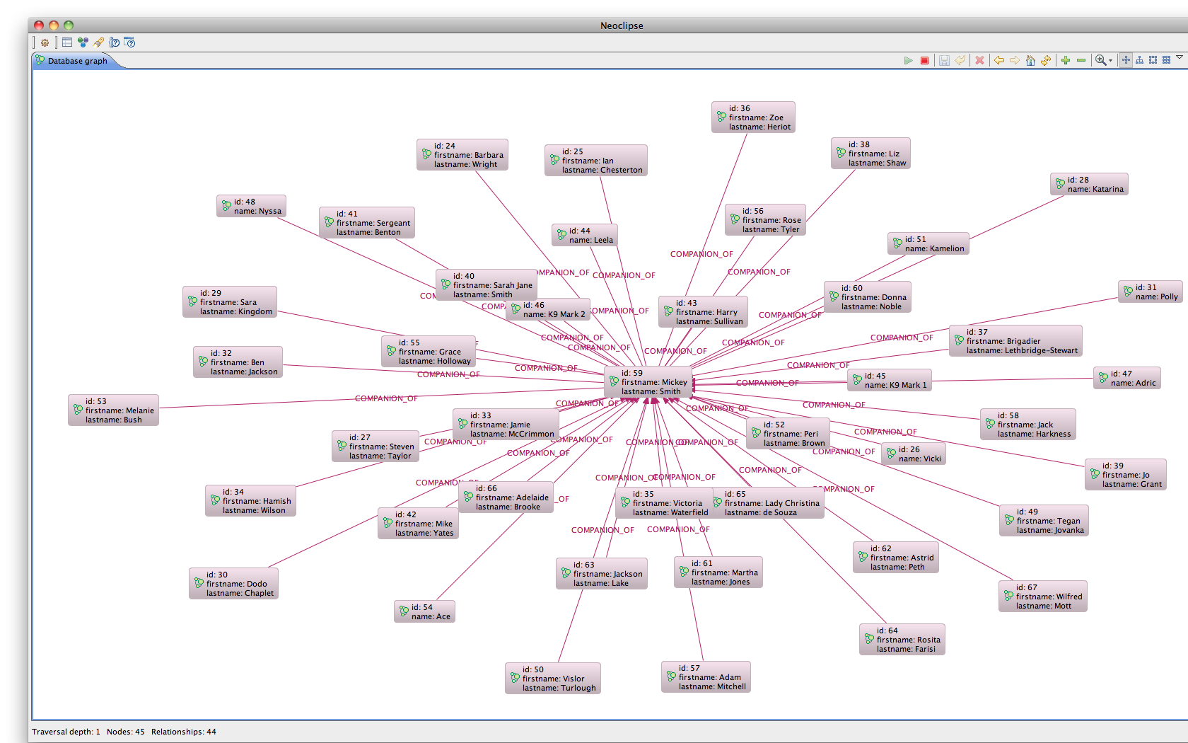
Repeat...until…

Slide 49
The Enemy of my Enemy is my…?
Node theMaster = …
Node dalek = …
Node cyberman …
Traverser traverser = Traversal.description().expand(
Traversal.expanderForTypes(DoctorWhoUniverse.ENEMY_OF, Direction.OUTGOING))
.depthFirst().evaluator(new Evaluator() {
public Evaluation evaluate(Path path) {
// Only include if we're at depth 2, for enemy-of-enemy
if(path.length() == 2) {
return Evaluation.INCLUDE_AND_PRUNE;
} else if(path.length() > 2){
return Evaluation.EXCLUDE_AND_PRUNE;
} else {
return Evaluation.EXCLUDE_AND_CONTINUE;
}
}
}).uniqueness(Uniqueness.NODE_GLOBAL)
.traverse(theMaster);
Notes:
Sometimes the Doctor faces more than one foe. The Master can be found orchestrating other enemies behind the scenes.
But sometimes it’s not straightforward, the universe is a tough place and enemies don’t always just align against the doctor
INCLUDE_AND_PRUNE is a pre-canned evaluator – it means include this node, but stop searching down this path
EXCLUDE_AND_PRUNE is a pre-canned evaluator – it abandons this node and the current search path
EXCLUDE_AND_CONTINUE is a pre-canned evaluator – it means exclude this node and continue
Can write our own evaluators if this doesn’t do it for us.
In our graph, this tells the Master that the Daleks and the Cybermen are enemies of the Doctor. Time for an alliance perhaps?

Slide 50
Graph Algorithms
The Doctor and the Master been around for a while
But what’s the key feature of their relationship?
They’re both timelords, they both come from Gallifrey, they’ve fought…
Graph algorithms can help
They’re pre-canned, well known traversals

Slide 51
Shortest Path
What’s the most direct path between the Doctor and the Master?
Node theMaster = …
Node theDoctor = …
int maxDepth = 5;
PathFinder<Path> shortestPathFinder = GraphAlgoFactory.shortestPath( Traversal.expanderForAllTypes(), maxDepth);
Path shortestPath =
shortestPathFinder.findSinglePath(theDoctor, theMaster);
Notes:
The Doctor and the Master are connected by many possible paths
- Both Timelords (species)
- Both from Gallifrey
- Both visited Earth
- Both own tardises
- Both enemies of each other is the shortest path though, and it defines the most important characteristic of their relationship
No more than depth 5, or we find Kevin Bacon!
Turns out a single relationship ENEMY_OF is the shortest path, and this defines the most important interaction between the Doctor and the Master

Slide 52
Koan 1
Tools

Slide 53

Neoclipse
http://wiki.neo4j.org/content/Neoclipse_Guide
Notes:
Eclipse RCP based tool, pre-built for Mac, Windows, Linux
Point it at a database directory and start to visualise. Great for debugging graphs.
Note: DB must be cleanly shut down for Neoclipse to work.

Slide 54
Neo4j Shell
See: http://wiki.neo4j.org/content/Shell
Command-line tool, based on the unix shell
Server mode
Connect to a running server
Use –port and –name switches to connect
File mode
Bind to a Neo4j store, just like Neoclipse
Use –path switch
Readonly mode with –readonly switch

Slide 55
Launching the shell (mac/unix)
#!/bin/sh
# Set this to your own project directory
PROJECT_DIR=/Users/jim/Neo/Development/neo4j-tutorial
LIB_DIR=$PROJECT_DIR/lib
java -cp $LIB_DIR/neo4j-shell-1.3-SNAPSHOT.jar:$LIB_DIR/neo4j-kernel-1.3-SNAPSHOT.jar:$LIB_DIR/geronimo-jta_1.1_spec-1.1.1.jar org.neo4j.shell.StartClient
-path $1

Slide 56
Launching the shell (windows)
REM Set this to your own project directory
set PROJECT_DIR=Z:\MYDO~0F4\Neo\Development\neo4j-tutorial
set LIB_DIR=%PROJECT_DIR%\lib
java -cp %LIB_DIR%\neo4j-shell-1.3-SNAPSHOT.jar;%LIB_DIR%\neo4j-kernel-1.3-SNAPSHOT.jar;%LIB_DIR%\geronimo-jta_1.1_spec-1.1.1.jar org.neo4j.shell.StartClient
-path %1

Slide 57
Shell Commands
cd
ls
cd <node-id> traverse one relationship to the adjacent node id.
cd -a <node-id> traverse to node id.
cd -r <relationship-id> traverse to a relationship which has the current node as either start or end. To see the relationship ids use the ls -vr command on nodes.
cd -ar <relationship-id> absolute change to any relationship.
cd .. traverses back one step.
cd start traverses to the start node of the relationship
cd end traverses to the end node of the relationship.
ls lists the current node/relation
ls *foo* lists anything matching the regex
-i ignores case
ls -d filters on direction
INCOMING, OUTGOING, BOTH
in, out, both
i, o, b

Slide 58
Shell Commands
mkrel
remrel
mkrel –c for node
mkrel –t for relationship
mkrel -t "LIKES" -d OUT –c creates a “likes” relationship to a new node
As mkrel, but removes nodes and relationships

Slide 59
Setting, Changing, Removing Properties
set
-t optional type
set name "The Doctor"
set -t int age 904
set -t String[] goodies ["sonic screwdriver", "jelly babies"]
mv
mv name character
rm
rm character

Slide 60
Goals
Browse the Doctor Who Database with Neoclipse
CRUD some nodes and relationships
Interact with the Doctor Who database via the shell
CRUD some nodes and relationships

Slide 61
Koan 2
Java API Graph Fundamentals

Slide 62
Core API
Deals with graphs in terms of their fundamentals:
Nodes
Properties
KV Pairs
Relationships
Start node
End node
Properties
KV Pairs

Slide 63
Koan 3
Indexing

Slide 64

Graphs are self-indexing
Notes:
We don’t use indexes as much in graphs as we do in RDBMS/Document stores because graphs are their own indexes. We tend to use indexes only as a shortcut for remembering interesting (sets of) nodes.
Here’s a graph of all the doctor’s companions. To “index” them all we need to do is find the doctor node and look for incoming “COMPANION_OF” relations
Remember that graph traversals are quick – 1M per second on commodity hardware, so looking finding all of the Doctor’s companions from the Doctor node is fast.

Slide 65
Indexing a Graph?
Graphs are their own indexes!
But sometimes we want short-cuts to well-known nodes
Can do this in our own code
Just keep a reference to any interesting nodes
Indexes offer more flexibility in what constitutes an “interesting node”

Slide 66
No free lunch
Indexes trade write cost for read speed
Just like any database, even RDBMS
Don’t index every node!
(or relationship)
Notes:
Just index key nodes – the pillars or themes that underpin your domain
In Doctor Who, we index the main characters and planets, and species since these are good starting nodes for traversals.

Slide 67
Lucene
The default index implementation for Neo4j
Default implementation for IndexManager
Supports many indexes per database
Each index supports nodes or relationships
Supports exact and regex-based matching
Supports scoring
Number of hits in the index for a given item

Slide 68
Creating a Node Index
GraphDatabaseService db = …
Index<Node> planets = db.index().forNodes("planets");
Type
Create or retrieve
Type
Index name

Slide 69
Creating a Relationship Index
GraphDatabaseService db = …
Index<Relationship> enemies = db.index().forRelationships("enemies");
Create or retrieve
Type
Type
Index name

Slide 70
Exact Matches
GraphDatabaseService db = …
Index<Node> actors = doctorWhoDatabase.index() .forNodes("actors");
Node rogerDelgado = actors.get("lastname", "Delgado") .getSingle();
Key
Value to match
First match only

Slide 71
Query Matches
GraphDatabaseService db = …
Index<Node> enemies = doctorWhoDatabase.index() .forNodes("enemies");
Node rogerDelgado = enemies.query("species", "S*n");
Method
Query
Key

Slide 72
Must use transactions to mutate indexes
But mutating access is still protected by transactions
Which cover both index and graph
GraphDatabaseService db = …
Transaction tx = db.beginTx();
try {
Node nixon= db.createNode();
nixon("name", "Richard Nixon");
db.index().forNodes("characters").add(nixon, "name", nixon.getProperty("name"));
tx.success();
} finally {
tx.finish();
}
Notes:
Incidentally Richard Nixon becomes a Doctor Who character in the most recent series!

Slide 73
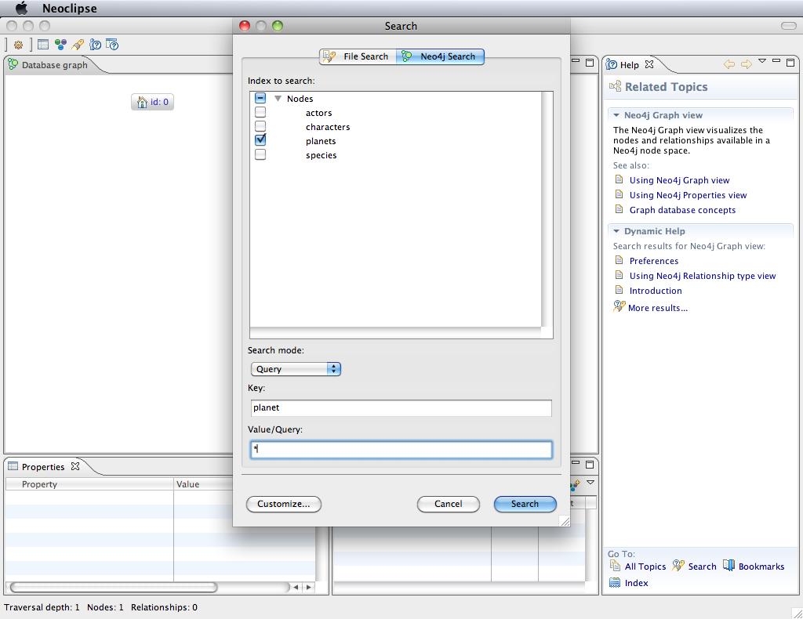
For Debugging: Neoclipse Supports Indexes

Slide 74
Koan Four
Idiomatic Searches

Slide 75
Mixing Core API and Indexes
Indexes are typically used only to provide starting points
Then the heavy work is done by traversing the graph
Can happily mix index operations with graph operations to great effect

Slide 76
Koan Five
Traversal APIs

Slide 77
Comparing APIs
Core
Traversers
Basic (nodes, relationships)
Fast
Imperative
Flexible
Can easily intermix mutating operations
Expressive
Fast
Declarative (mostly)
Opinionated

Slide 78
(At least) Two Traverser APIs
Neo4j has abstracted the notion of traversers into frameworks
There are two of these
And development is active
No “one framework to rule them all” yet

Slide 79
Simple Traverser API
Mature
Designed for the 80% case
Node daleks = …
Traverser t = daleks.traverse( Order.DEPTH_FIRST,
StopEvaluator.DEPTH_ONE,
ReturnableEvaluator.ALL_BUT_START_NODE,
ENEMY_OF,
Direction.OUTGOING );
Notes:
Finds who the Daleks are enemies of.
Result: the Doctor (of course), the timelords, and the cybermen!
Note in this case the order doesn’t matter since we’re only going to depth one.
StopEvaluator can also be END_OF_GRAPH or custom implementation based on TraversalPosition
ReturnableEvaluator can be ALL or custom implementation based on TraversalPosition

Slide 80
“New” Traverser API
Newer (obviously!)
Designed for the 95% use case
Written in Swedlish, fluent API design
Traverser traverser = Traversal.description().expand(
Traversal.expanderForTypes(DoctorWhoUniverse.ENEMY_OF, Direction.OUTGOING))
.depthFirst().evaluator(new Evaluator() {
public Evaluation evaluate(Path path) {
// Only include if we're at depth 2, for enemy-of-enemy
if(path.length() == 2) {
return Evaluation.INCLUDE_AND_PRUNE;
} else if(path.length() > 2){
return Evaluation.EXCLUDE_AND_PRUNE;
} else {
return Evaluation.EXCLUDE_AND_CONTINUE;
}
}
}).uniqueness(Uniqueness.NODE_GLOBAL)
.traverse(theMaster);

Slide 81
Koan Six
Graph Algorithms

Slide 82
Koan Seven
Graph Algorithms

Slide 83
Koan Eight
Graph Matching

Slide 84
Koan Nine
The REST API

Slide 85
Ops and Big Data
Neo4j in Production, in the Large

Slide 86
Two Challenges
Operational considerations
Data should always be available
Scale
Large dataset support

Slide 87
Neo4j HA
The HA component supports master-slave replication
For clustering
For DR across sites
Notes:
The HA component uses log shipping under the covers to ensure eventual consistency across database instances
We use Zookeeper to elect cluster masters, even in the event of failure/partition (PAXOS algorithm)

Slide 88

HA Architecture

Slide 89

Write to a Master
Writes to the master are fast
And slaves eventually catch up

Slide 90

Write to a Slave
Writes to a slave cause a synchronous transaction with the master
And the other slaves eventually catch up

Slide 91
So that’s local availability sorted, now we need Disaster Recovery

Slide 92
HA Locally, Backup Agent for DR
Notes:
The backup agent registers with the master for

Slide 93
But what about backup?

Slide 94
Same Story!

Slide 95

Scaling Graphs is Hard
Notes:
The black-hole problem: popular nodes get lumped together on a single instance, but there is low point cut

Slide 96

Scaling Graphs is Hard
Notes:
Load-leveling alone can lead to many relationships crossing instances.
These are very expensive to traverse, networks are many orders of magnitude slower than in-memory traversals

Slide 97

Scaling Graphs is Hard
Notes:
There are well-known algorithms that help with keeping graphs balanced (the Minimum Point-Cut problem)
They can work at
- insert-time
- periodically
Each has different properties, but good ones take a local view of the graph (no global locks) and work incrementally (short bursts).
They can even take into account use patterns.
But this is still an open research area. Graphs are highly mutable and so these algorithms face an uphill fight, even if we could get them right.
Unlike other NoSQL stores, graph’s simply aren’t predictable, and so we can’t use techniques like consistent hashing for scale out.

Slide 98
So how do we scale Neo4j?
First we clarify “scale”
Notes:
Not all databases need to be Facebook scale.
Most enterprise deployments have much more modest usage.

Slide 99
A Humble Blade
Blades are powerful!
A typical blade will contain 128GB memory
We can use most of that
If O(dataset) ≈ O(memory) then we’re going to be very fast
Remember we can do millions of traversals per second if the caches are warm
Notes:
10s of gigabytes:
Slam in the RAM on a single server and all is plain sailing

Slide 100
Cache Sharding
A strategy for coping with large data sets
Terabyte scale
Too big to hold all in RAM on a single server
Not too big to worry about replicating it on disk
Use each blade’s main memory to cache part of the dataset
Try to keep caches warm
Full data is replicated on each rack

Slide 101

Consistent Routing
Notes:
Consistent Routing c.f. Consistent hashing name – means always try to route related requests to the same server to hopefully benefit from warm caches

Slide 102
Domain-specific sharding
Eventually (Petabyte) level data cannot be replicated practically
Need to shard data across machines
Remember: no perfect algorithm exists
But we humans sometimes have domain insight
Notes:
Some domains naturally shard.
E.g. geo where the connections between cities are few compared with the connections within the cities. So can place cities or countries on different nodes
E.g. user content, where connections between normal users are few (modulo any celebrities).

